Slide 1
Corporate Profile
CEM Business Solutions

Slide 2

About us
Established in 2003
97.7% Customer Satisfaction
12 offices in 8 International locations
ISO 9001-2008 Certification
Only regional company with CfMD certification
278 Customers in 19 industries
Good CSR & value system
Development Centre in India
Service to Channel and End users

Slide 3
Business Consulting Services
Business Consulting Services
Business Consulting
Implementation
Outsourcing
Staffing
Need Analysis
Business Process Re-engineering
Project Management
Yield analysis
Optimization
ERP
CRM
Business Intelligence
HR & Payroll
Time & Attendance
Cloud Solutions
Offshore development
Customizations
Reports development
Data migration
Dashboards
Onsite & Offsite Manpower Deployment
Formation of CEM Cloud Services

Slide 4

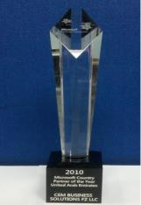


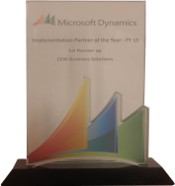


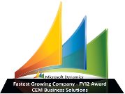


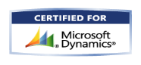
CEM – Microsoft Dynamics Awards
2013
2012
2011
2010
2009
Microsoft Dynamics Awards
Invited Member of
Microsoft Partner Council (MPC)
Partner Advisory Board (PAB)
Enterprise Product Group (EPG)
Member of Microsoft Dynamics AX Council Program
CEM AX Payroll earns CfMD Certification
2012 Microsoft President’s Club Member
Fastest growing Company
Microsoft Best Marketing Partner
Microsoft Best Implementation Partner
2011 Microsoft President’s Club Member
2010 Microsoft Country Partner
Microsoft Best Implementation Partner
2009 Microsoft President’s Club Member
Microsoft Best Implementation Partner
Microsoft Best Sales Partner

Slide 5
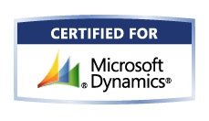
CfMD Certification
CfMD Certification
Microsoft Corporation’s highest standard for partner-developed software
Rigorous software testing by Microsoft, VeriTest and Lion Bridge in multiple locations including China.
Source Code in Escrow account in Europe
Must have at least 10 customers’ endorsements before certification
The solution provider should be a gold Certified Partner

Slide 6









Offices
USA
UK
India
UAE
Singapore
Qatar
Kuwait
Oman
12 Offices in 8 International locations

Slide 7









Industries
Construction
Project Services
Facility Management
Food & Beverage
Agriculture
Aviation
Automotive
Marine
Oil & Gas
Insurance
Banking
Manufacturing
Real Estate
Health & Fitness
Transportation
Trade & Logistics
Retail
Equipment Rental
Telecom
Notes:
Microsoft Dynamics AX 2012 R2 - HCM
Drive HR Impact (Core HRMS)
Personnel Actions and Workflow
Users will be given the option to configure AX to require a more formal way to create new positions and edit positions, with the additional option of AX Workflow as part of the formal action, plus a way to view a history of actions in HR.
For creating one position or multiple positions
For editing position fields, except the position worker assignment field. You can multi-select positions to edit and then edit multiple fields on the position.
Position Budgeting
Tracking of Budget/Cost information in HR - for Position Salary Budget and Position Expended/Position benefit budgets (via Position budget grid)
Ability to create a staging environment for planning next years budget prior to integration with Budget planning.
Integration to budgeting solution (via Budget plan generation- Generate from position forecasting)
Expand on Dimension functionality for integration to budget control (by allowing the budget for a position to be split by more than one position)
Budget generation from position forecasting will generate budget plan lines that will support the ability to:
View and modify the results of multiple forecasts in budget plan scenarios in Budget planning
View and modify budgeted information by budget period
Approved plan amounts are used to create budget register entries in Dynamics AX budget control which then provides the user with the ability to:
View budget to actuals for salaries and benefits using Budget control statistics
View budget to actuals by position when position is used as a financial dimension
Maintain Positions
Copy an existing position as a way to Mass create positions
Mass edit position attributes which includes the ability to Mass expire positions
Mass terminate workers
Add a means to "freeze" or block worker assignments to a position (adding a Available for assignment datetime field)
Benefits Eligibility
Provides an eligibility engine for Benefits. Employees will be eligible for a set of benefits based on the rules of this engine.
Accessing and exercising benefit eligibility rules to determine worker eligibility
Screenings
Screening types like drug or medical, can be setup and associated to Jobs. Results recorded for the worker and can setup as reoccurring so it auto sets up the next screening.
Enhanced Role Centers
Role Center for HR Manager where you could get Injury & Illness Incidents for the month, year, and last year
Or Staffing Manager, where you could see Average days to Recruit for each Department or Applicants by Source
And Training and Development Manager, where you could see information about Open Courses or how many people have taken a particular course
U.S. Payroll
Including HR and Payroll integration
Ceridian Tax Filing Service
Manage Talent (Talent Management)
Tests and Qualifications
Setup of Qualification Test Types, which would be added as defaults on Job and Position, and carried into Recruitment process; i.e., required Tests & minimum scores
Compensation
Enable mass adjustments of compensation structures

Slide 8


CEM AX Construct
Advanced Project Management
Subcontract
Management
Advanced Inventory
Management
CEM has built a number of add on modules in AX 2012 for construction, general contracting, sub-contracting and project related service industries.
These modules connect the ‘business critical’ project sites, warehouses and project related procurement with the financials of Microsoft Dynamics AX 2012.
Rental
Workforce
Augmentation
Plant, Machinery & Vehicle (PMV) Management
Cost Control
Work Breakdown Structure (WBS)
Progress Monitoring
Time Management
Estimation
Staff
Accommodation
Concrete
Purchase
Tool Management (Scaffolding)
Performance Ranking

Slide 9
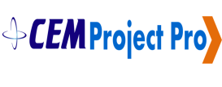

CEM Project Pro
WBS Summary
Project Pro provides crucial business analytics for your planners and top management. Complex analytical reports can be made in less than half hour by taking the raw data captured on projects and running the simulations and calculations culminating in the final analytical report.
Root cause PARETO analysis
Progress
Monitoring
Projects roll up
Periodic overall Progress
Performance
Ranking
Particular Activity

Slide 10

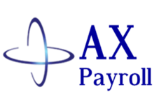
CEM AX Payroll (CfMD Certified)
Leave Management
Claims Management
Loans & Advances Management
Time & Attendance
Management
EOS(End of service) Administration
CEM AX Payroll helps you to reduce payroll processing time, avoid human errors and improve accuracy. This supports multi country, multi-currency operations.
In addition, these manpower costs are posted in AX 2012 to gain detailed insight into personnel and project cost.
Social Security Management
Payroll Processing
Payroll Disbursement & Financial Integration

Slide 11

CEM AX Union Payroll
UNION PAYROLL
Leave
Management
Union
Payroll
Loans & Advances Management
Time & Attendance
Management
Employee Relations Management
CEM AX Payroll has a module to handle all union payroll activities.
If you have union workers on payroll, CEM AX Payroll can help you there as well. You can load multiple union tables into AX payroll, defining pay, deductions and fringe benefits by employee trade codes.
Social Security Management
Payroll
Processing
Insurance Management

Slide 12
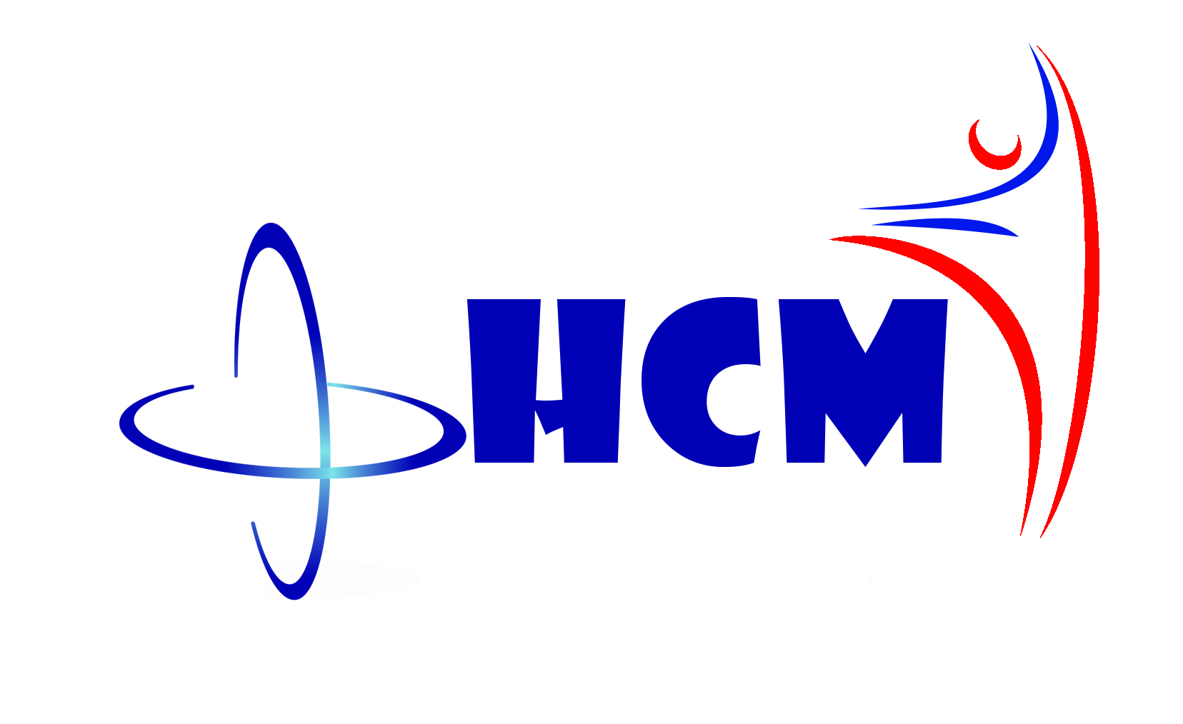

CEM AX HCM
Manpower Planning & Budgeting
Recruitment Management
Employee Recognition
Talent Management
Performance Management
Payroll Management
Transfer & Promotions
In this digital era, everything can be automated except human resource functions. However, efficiently managed human resources can produce great results. CEM AX HCM is designed to deliver the highest results and is fully integrated with AX 2012.
“Manage your most important asset – Your people with CEM AX HCM”
Training Management
Enterprise Self Service
Career Planning & Development
Reports & Dashboards

Slide 13
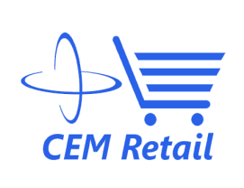

CEM AX Retail Plus
Supplier trade agreements control
Price check systems
Digital display integration
CEM AX Retail Plus is a powerful retail solution, with which competitive retailers can connect point-of-sale to enterprise resource planning and financials right out of the box.
CEM AX Retail Plus developed on top of Microsoft Dynamics AX injects the retailers with the exact customer behaviour and preferences, and helps them optimize a whole chain of operations, right from sales to supply and distribution.
Weigh scale
(Veg / Meat) integration
POS zero downtime
fuzzy logic
Advance workflow
Loyalty
schemes
Online
shopping cart
Check sum
Inter branch
Stock visibility,
blocking & delivery
Off line data sync with authentication
A4
Printing
3 decimals
Add on
Return goods control
Gift
card
Customer service through POS

Slide 14



CEM Team
Over a millions hours of Dynamics experience
Committed to ‘Timely & Quality’ delivery
Qualified people from premium institutes
Onsite / Offshore experience
Incentivized for FTR (First time Right)
Sub contractor experience with large MNCs

Slide 15

Why CEM
Domain expertise in 19 industry verticals
97.7% Customer Satisfaction
End to end service from implementation to support
Over Million hours of Microsoft Dynamics experience
24x7 Operations
Successful timely project completion
265
happy customers
Proven “Sure Step Methodology”
Microsoft Dynamics Best implementation partner 3 years
in a row
Lower TCO (Total cost of ownership)
by blended model
Notes:
Microsoft Dynamics AX 2012 R2 - HCM
Drive HR Impact (Core HRMS)
Personnel Actions and Workflow
Users will be given the option to configure AX to require a more formal way to create new positions and edit positions, with the additional option of AX Workflow as part of the formal action, plus a way to view a history of actions in HR.
For creating one position or multiple positions
For editing position fields, except the position worker assignment field. You can multi-select positions to edit and then edit multiple fields on the position.
Position Budgeting
Tracking of Budget/Cost information in HR - for Position Salary Budget and Position Expended/Position benefit budgets (via Position budget grid)
Ability to create a staging environment for planning next years budget prior to integration with Budget planning.
Integration to budgeting solution (via Budget plan generation- Generate from position forecasting)
Expand on Dimension functionality for integration to budget control (by allowing the budget for a position to be split by more than one position)
Budget generation from position forecasting will generate budget plan lines that will support the ability to:
View and modify the results of multiple forecasts in budget plan scenarios in Budget planning
View and modify budgeted information by budget period
Approved plan amounts are used to create budget register entries in Dynamics AX budget control which then provides the user with the ability to:
View budget to actuals for salaries and benefits using Budget control statistics
View budget to actuals by position when position is used as a financial dimension
Maintain Positions
Copy an existing position as a way to Mass create positions
Mass edit position attributes which includes the ability to Mass expire positions
Mass terminate workers
Add a means to "freeze" or block worker assignments to a position (adding a Available for assignment datetime field)
Benefits Eligibility
Provides an eligibility engine for Benefits. Employees will be eligible for a set of benefits based on the rules of this engine.
Accessing and exercising benefit eligibility rules to determine worker eligibility
Screenings
Screening types like drug or medical, can be setup and associated to Jobs. Results recorded for the worker and can setup as reoccurring so it auto sets up the next screening.
Enhanced Role Centers
Role Center for HR Manager where you could get Injury & Illness Incidents for the month, year, and last year
Or Staffing Manager, where you could see Average days to Recruit for each Department or Applicants by Source
And Training and Development Manager, where you could see information about Open Courses or how many people have taken a particular course
U.S. Payroll
Including HR and Payroll integration
Ceridian Tax Filing Service
Manage Talent (Talent Management)
Tests and Qualifications
Setup of Qualification Test Types, which would be added as defaults on Job and Position, and carried into Recruitment process; i.e., required Tests & minimum scores
Compensation
Enable mass adjustments of compensation structures

Slide 16

Contact Us
United States
50 Tice Blvd, Suite 340
Woodcliff Lake, NJ 07677
Tel : +1 (201) 391-5345
4944 Sunrise Blvd.
Suite B-4,Fair Oaks,
CA 95628
United Kingdom
4 Morel Mews, Dagenham RM8
1 BW Essex
Tel : +44 207 993 6483
Singapore
10 Anson Road,
#26-04 International Plaza,
Singapore 079903
Tel : +65 9757 5768
United Arab Emirates
119, Building No. 10, Dubai Internet City, P.O. Box 502270, Dubai, U.A.E.
Tel : +971 43911683
1403, Al Zahraa Tower , King
Faisal Street, Sharjah, U.A.E.
Tel : +971 6 5734700
Kuwait
P.O. Box 36350, AI Rass 24754,
Kuwait,
Tel : +965 - 22622063
Qatar
P.O. Box #51, Doha Qatar
Tel: +974 300 75 145
Oman
Opening Shortly!
India
No:85, Babu Street, Vellala,
Teynampet, Chennai 600 086
Tel : +91 44 33083800

